Slide 1
BRITISH AIRWAYS CUSTOMER REVIEWS ANALYSIS
By:Sharon Muiruri

Slide 2
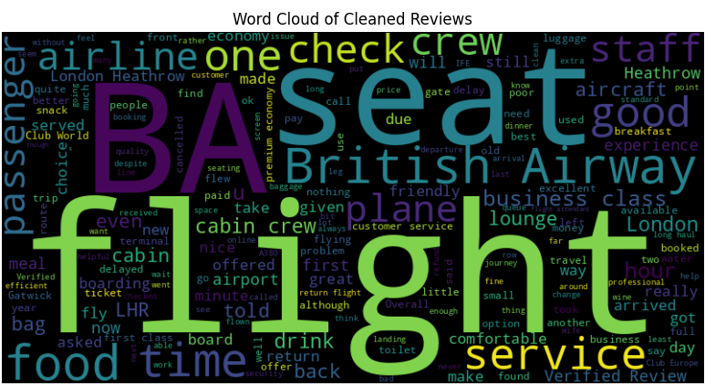
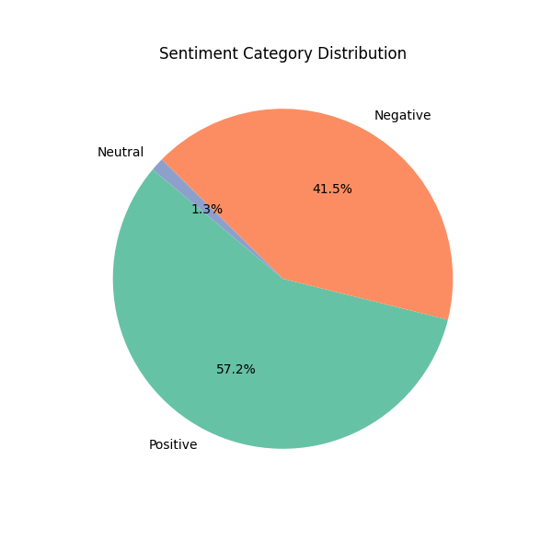
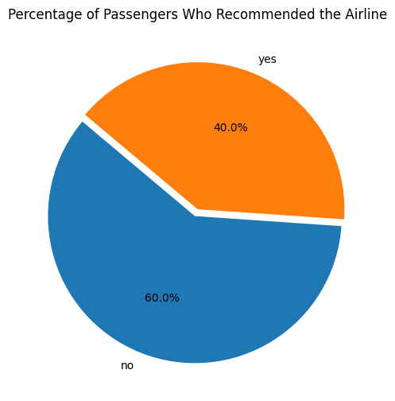
Key Insights
- The overall average rating score for the airline was 4.68
- 57% of the reviews were positive, while 41% were negative and 1 % neutral.
- 60% of passengers would not recommend the airline, suggesting potential areas of dissatisfaction or unmet expectations in services provided by the airline.
- Majority of the reviews have themes around service quality, comfort, food, airport logistics, and seating. These insights could guide BA to target improvements in service, comfort, and catering to enhance customer satisfaction.

Slide 3
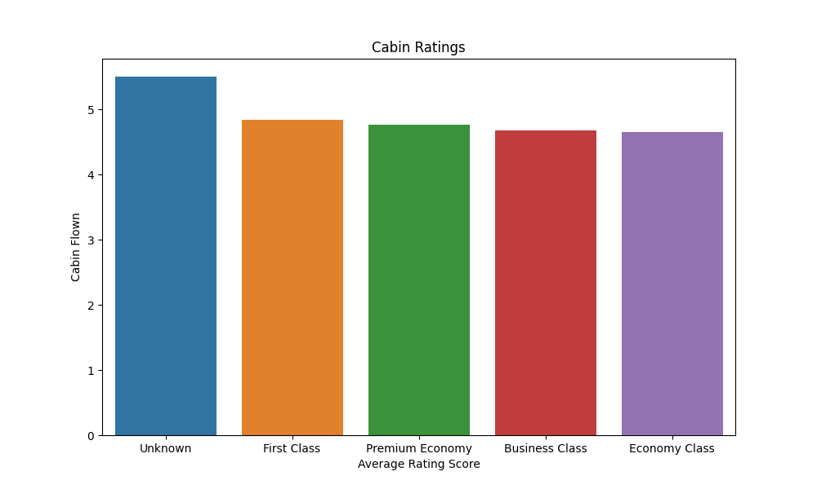
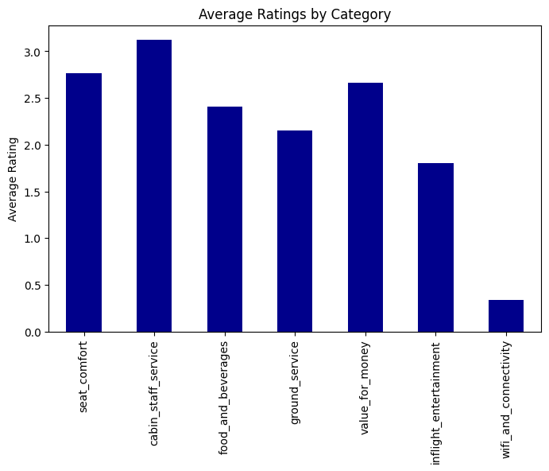
- The ratings indicate a positive experience for premium cabins (First and Premium Economy), while Economy and Business Class show areas where British Airways could focus on enhancing service or comfort.
- Improving Economy Class and maintaining high standards in premium cabins can help BA ensure better overall customer satisfaction across all cabin classes.
- Cabin and Staff Service have the highest average rating, indicating that passengers are generally satisfied with the service provided by the cabin crew. This suggests that the staff’s professionalism and friendliness are positively perceived.
- There are notable areas for improvement, particularly in inflight entertainment and WiFi connectivity. Enhancing these lower-rated aspects could lead to a more balanced and satisfactory passenger experience.

